Slide 1
Mobile Forensics
04/15/2019

Slide 2
Announcement
Final exam – Saturday May 4th, 1330 (venue to be announced)
Final Project presentations – 22nd and 26th
Posted in the Course folder, the rubric for grading the team projects

Slide 3
Coverage
Go over 12 week exam
Lessons we learnt from San Bernardino case
iOS (jailbreaking) vs Android (rooting)
Forensic investigation of an iPhone
Backups and snapshots
Forensic investigation of an Android

Slide 4
San Bernardino Case (2016)
Apple received requests from the San Bernardino, FBI to assist in obtaining information from locked iPhones.
The FBI believed a specific phone contained information critical to an investigation involving national security concerns.

Slide 5
San Bernardino
The FBI attempted to compel Apple to develop a weakened encryption standard and embed that weakened encryption design into a new operating system that could be loaded onto the device in question.
Eventually, after a long drawn-out battle, the San Bernardino FBI branch was able to access the device by hiring a third-party corporation to defeat the built-in security measures

Slide 6
What are the lessons learnt?
Government officials can request manufacturers of technology to unlock their technology or provide a backdoor when the government deems necessary.
Sometimes companies comply else govt agency can bypass device security using whatever means available.
Apple device security→ made it difficult to use most traditional ways to forensically investigate the device

Slide 7
iOS Architecture
Apple restricts any communications from applications to talk directly to the hardware or even certain parts of the operating system.
All applications must use and communicate via accepted APIs and methods.
Applications on an iOS device as being sandboxed from other applications. Why is this an issue?

Slide 8
Why is this an issue?
Most security applications need access to other applications to evaluate them for threats.
Application segmentation design prohibits most security technology from functioning properly, which is why there isn’t software like antivirus available for iOS.
Some develops jailbreak the iOS. What is jail breaking?

Slide 9
Jailbreaking
Process of removing any software restrictions of the device that have been mandated by Apple.
Jailbreaking occurs on iOS (iPhones, iPads, iPod Touch devices) as well as tvOS (Apple TV) devices.
Jailbreaking, in most cases, allows applications and the user root access to the device, allowing them to install applications, extensions, utilities, and themes that are not available through the AppStore.
Security risks associated
Most jailbreaking techniques do not work or yield any decent forensics evidence??? Why and why talk about it?

Slide 10
Tools for jail breaking
RedSn0w, developed by the iPhone Dev Team.
it has been difficult to use RedSn0w since the release of iPhone 5.
iPhone 6s running iOS 9.0–9.0.2 - the Pangu team has released a public jailbreak for this model and code version.

Slide 11
Jailbreaking an iPhone
Download the Pangu 9 software- you can find it using your favorite search engine.
Disable services like Find my iPhone, Touch ID, and Passcode. If the phone has a passcode, you need that passcode to disable these services.
Launch the Pangu 9 application. On a Mac, simply run the application. If you are using Windows, make sure you right-click on the jailbreak application and run it as administrator.
Plug the mobile device you are investigating into your computer after you’ve opened Pangu. When your device has been detected, simply press Start to start.
Toggle Airplane mode. The onscreen instructions guide you through the rest of the installation.
Reboot. When you reboot the device, you can access the Cydia jailbreak software repository.

Slide 12
Rooting vs jailbreaking?
Apple's operating NOT open source system→ cannot make changes to the actual source code.
Android → open source operating system→ can do more than just install 3rd party apps.
Android allows for side loading - installation of third party apps.
Rooting allows you - to completely remove and replace the entire operating system of the device.
Android built on a Linux Kernel – allowing user administrative access

Slide 13
iTunes Forensics
What do you do if you are a corporate forensic investigator interested in iOS devices?
Examine the computer that has synced with the device
An iOS device can be synced with a computer using USB or Wi-Fi.
They normally sync automatically, which means they already have a PIN bypass, even when complex PINs are used.
Unencrypted data
Unfortunately, many users these days are syncing with iCloud or other cloud services, making iTunes syncing obsolete.

Slide 14
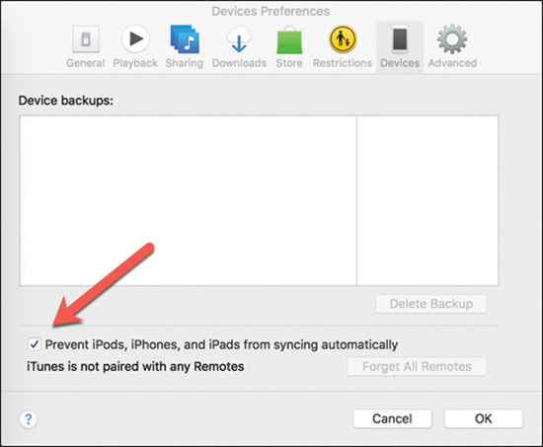
Examining iTunes forensics
Disable automatic syncing - you don’t want to accidentally overwrite any data →Preferences, Devices, and then select the option to stop syncing.

Slide 15
Tools that maybe used
A few tools, such as AnyTrans and iPhone Backup Extractor, can help extract iOS data. Literally hundreds of tools can read iPhone backups.
iPhone Backup Extractor
iPhone Backup Extractor enables you to examine and analyze iPhone backups from iCloud accounts as well (username and password).
It is also possible to have these accounts reset from Apple under a compelling court order.

Slide 16
iOS Snapshots
The most common way to examine this file system is looking at snapshots.
OS takes a snapshot of the screen when an application switches or is pushed to background. Snapshots are saved on the devices and located in the /private/var/mobile/Library/Caches/Snapshots folder
Snapshots are saved for every application that is used and active.
How many and for how long snapshots are saved:
when the user switches back to an application,
when the application is closed, and
the specific version of iOS the user is using.

Slide 17
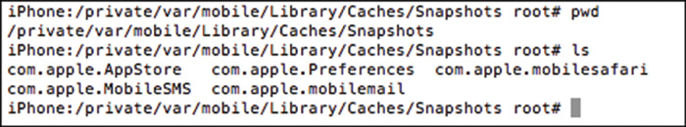
Snapshots
Obtaining snapshots is very difficult on modern iOS systems due to
Lack of jailbreaking techniques available to gain access to the file system and shell of the iOS devices.
Newer iOS systems use disk encryption by default, which makes examining snapshots difficult.

Slide 18
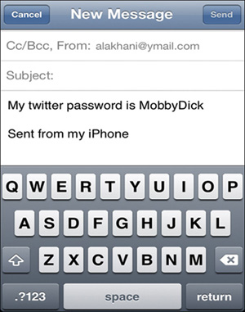
Snapshot of iOS mail application opened

Slide 19
Objectives
Hoe does email work?
Explain the role of e-mail in investigations
Describe client and server roles in e-mail
Describe tasks in investigating e-mail crimes and violations
Describe some specialized e-mail forensics tools

Slide 20
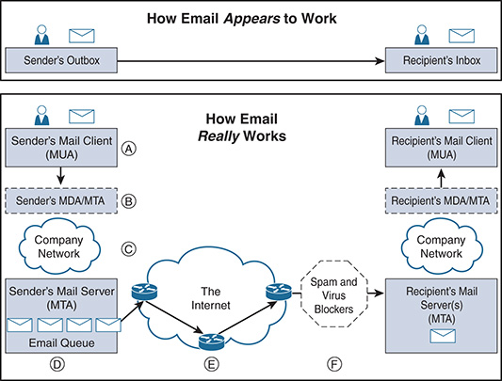
How does email work?

Slide 21
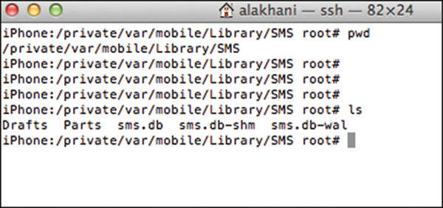
Examining the text and iMessages
Text and iMessages are located in the /private/var/mobile/Library/SMS directory
The file sms.db is a SQL Lite database that contains text messages, iMessages, and timestamps of messages
SQL Lite Manager –Firefox extension can be used to open the file

Slide 22
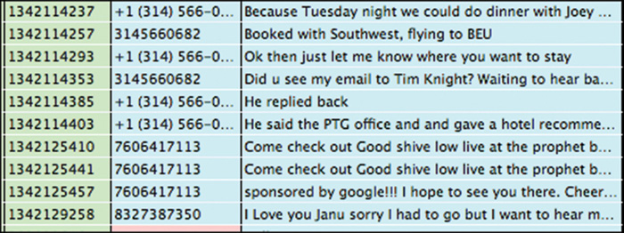
SQL Lite database

Slide 23
Android
Andy Rubin started Android in 2003
Google acquired Android Inc. in 2005
In 2007, the Open Handset Alliance was formed with the objective of creating open standards for mobile phones.
Android is an open source operating system distributed under the Apache license -anyone can use and run the operating system.

Slide 24
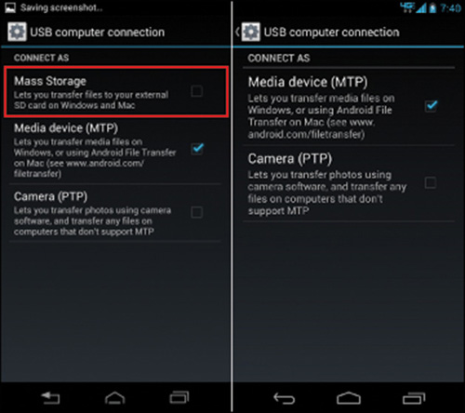
Android forensics
Connect the Android device via USB to your computer.
Turn on USB Mass Storage on the Android device in the setting area.
Turn on Media Device (MTP) – makes all file systems accessible

Slide 25
Android forensics
Examining modern Android systems is almost exactly like examining endpoints such as laptops and desktops.
Except Versions 6 and later encrypt the file system by default.
You need to decrypt the data to be able to successfully read it.
To decrypt
Attaching the encrypted disk to an Android emulator and brute force on the passcode or locked screen of the home screen
The next step in Android forensics is to gain full root access to the device if possible.

Slide 26
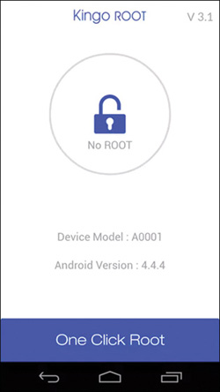
Rooting the device
Our favorite method to root an Android device is using the KingoRoot application.
Install the application and click the button to root.

Slide 27
Imaging
Once rooted and mass storage is enabled→ create an image of the internal storage drives and examine with disk forensics tool -FTK
After image, use FTK to view the contents
Pictures is typically found under Phone/DCIM.
The SMS database is typically located, by default, at /data/data/com.android.providers.telephony/databases/mmssms.db

Slide 28
PIN Bypass
Recent investigations, passcodes were normally set to difficult alphanumeric characters that wouldn’t be bypassed by a simple guess – iOS and Android are prompting users for complex passwords.
Fingerprint or facial recognition are being used.
Reported situations - when law enforcement officers forced suspects to place a thumb on a locked mobile device (may violate law).
Facial recognition now available – iPhone X

Slide 29
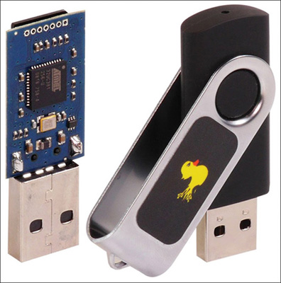
Brute force passcodes on locked screen (Rubber Ducky)
This USB device is a keyboard/keystroke injection device that delivers preprogrammed keystroke payloads at more than 1000 words per minute.
In most cases, you need a USB–to–micro USB adapter to use on a mobile phone

Slide 30
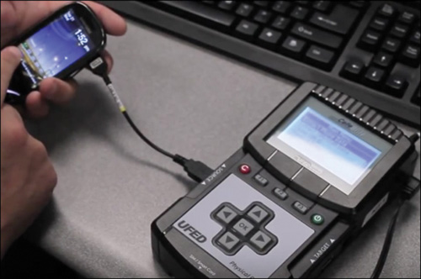
Cellebrite

Slide 31
Call logs and SMS spoofing
Don’t rely on call logs or SMS messages to determine the source of incoming phone calls or text/data messages.
A company may want to direct all internal phones that call out to look like a specific number.
Spoofing is generally considered illegal in the United States and many other countries when the intent is to defraud or cause harm.
Several caller ID spoofing service providers provide legitimate services caller and SMS spoofing in a legal manner -Spoof Card, Trap Call, and Spoof Tel.

Slide 32
What then do you do as an investigator?
Be aware of these services
Reconcile the records of both ends of a conservation with call and billing logs to determine if the call was truly made from the displayed caller ID recorded in these logs.

Slide 33
Burner phones
Cell phones (or SIMs) that are prepaid in cash.
Who is the person behind a phone number? How do we find this information?
Step 1. Obtain the phone number of the person you are trying to identify.
Step 2. Create a contact of that phone number in your phone.
Step 3. Upload your contacts to social media applications such as Snapchat, LinkedIn, Instagram, Facebook, Twitter, WhatsApp, and other applications you can think of.
Step 4. See if your unknown burner contact has a profile attached to it.

Slide 34
SIM Card Cloning
Be aware that cloning a SIM card is highly illegal in some countries.
Need to know that there are SIM card standards.
SIM cards are manufactured based on three algorithms: COMP128v1, COMP128v2, and COMP128v3 - COMP128v1 only one that can be cloned.
Obtain a blank SIM card (eBay).
Get a SIM card reader/writer - DIGIFLEX USB SIM Card Reader Writer Copy Cloner Backup GSM CDMA
Get appropriate software to copy and restore a SIM card (MagicSIM)

Slide 35
SIM card cloning
You may be prompted for a SIM unlock code.
You can call the mobile provider and tell them you trying to use the SIM card an overseas phone.
Professional tools that look more like what you see in the movies allow you to plug in a SIM card and automate the copying and cloning process.

